Slide 1
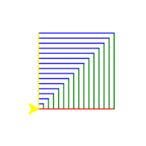
Week 1
Sequencing, Loops, Parameterless Functions
Blocks to Python
(https://trinket.io/blocks): Sequencing, Loops (bounded), Functions (parameterless?) – draw turtle graphics (squares) using blocks and investigate created Python code
Computational thinking:
1. Decomposition – breakdown task
1. decompose draw square into 4 line tasks;
2. Decompose draw house into multiple draw squares
2. Abstraction – hide unnecessary detail
: abstract draw person into stick figure
3. Pattern recognition – recognize class of problem
Refactoring sequential code into functions, e.g. square; Identify repeating code sequences and refactor to functions
4. Concurrency: multiple turtles to draw one house
2. Decisions
3. Functions
Preconditions: assert
4. Iteration
5. Lists
1D, 2D
6. Strings
7. Dictionaries and Data Files
8. Data structures & algorithms
Graphs
Binary search; linear search; breadth-first graph; post-order tree-traversal
Caching for performance
Pipelining
Notes:
https://www.bebras.org/sites/default/files/Computational_Thinking_Cheat_Sheet.pdf

Slide 2
https://runestone.academy/ns/books/index
https://runestone.academy/ns/books/published/httlacs/thinkcspy.html?mode=browsing
Image editing
https://runestone.academy/ns/books/published/fopp/index.html?mode=browsing
Notes:
https://libguides.ntu.edu.sg/python/introfunctions

Slide 3
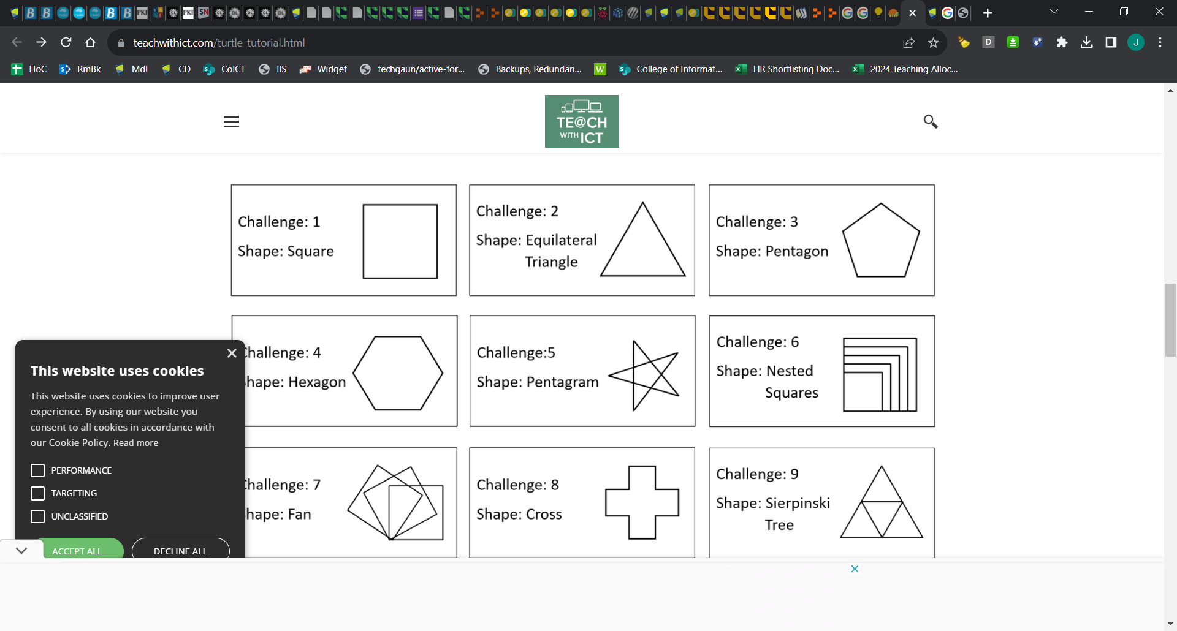
Week 1
Notes:
https://www.teachwithict.com/turtle_tutorial.html

Slide 4
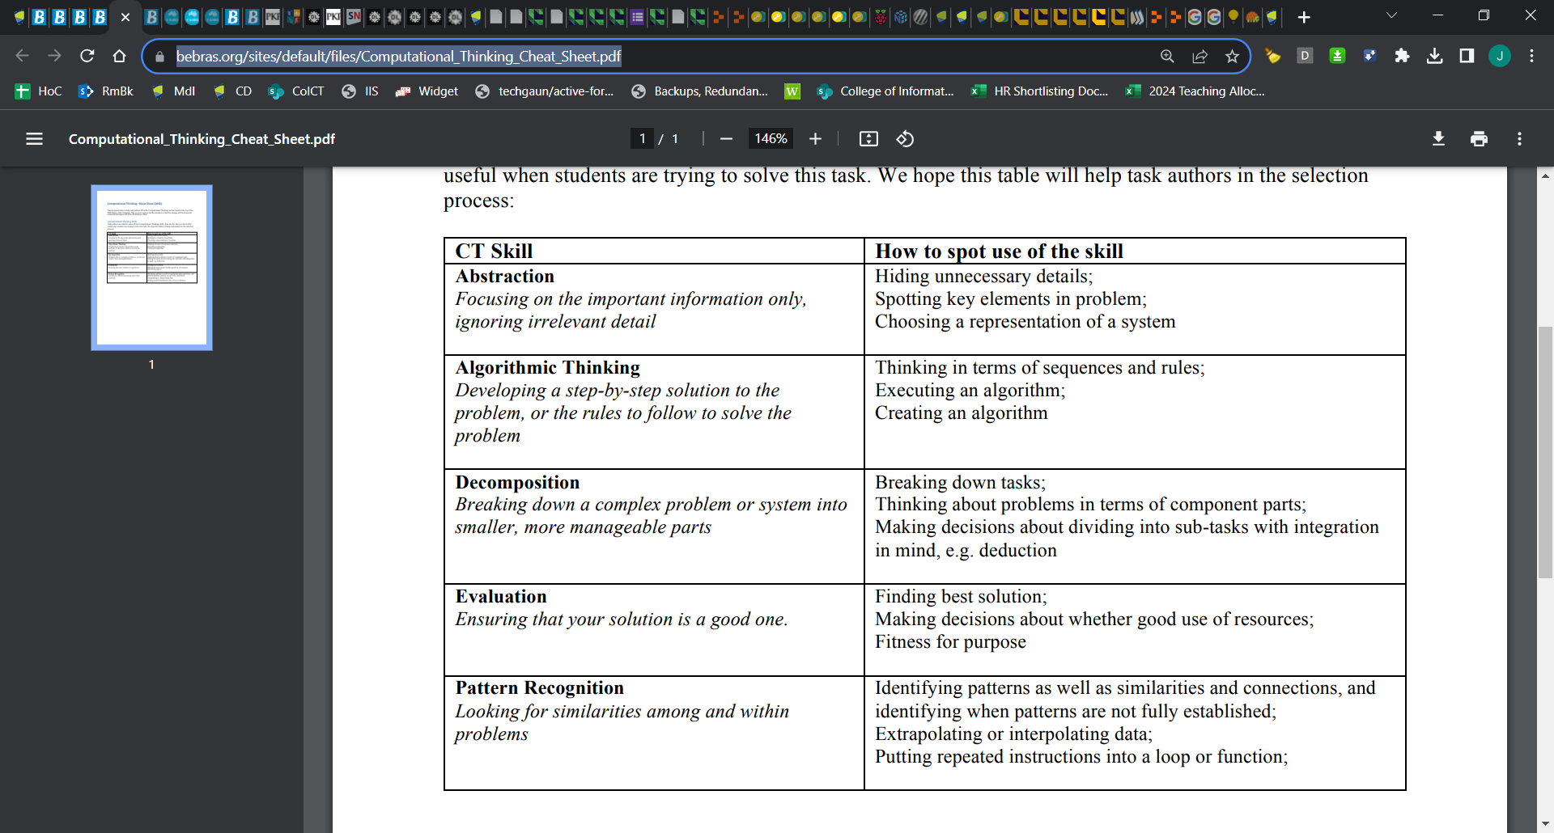
Notes:
https://www.bebras.org/sites/default/files/Computational_Thinking_Cheat_Sheet.pdf

Slide 5
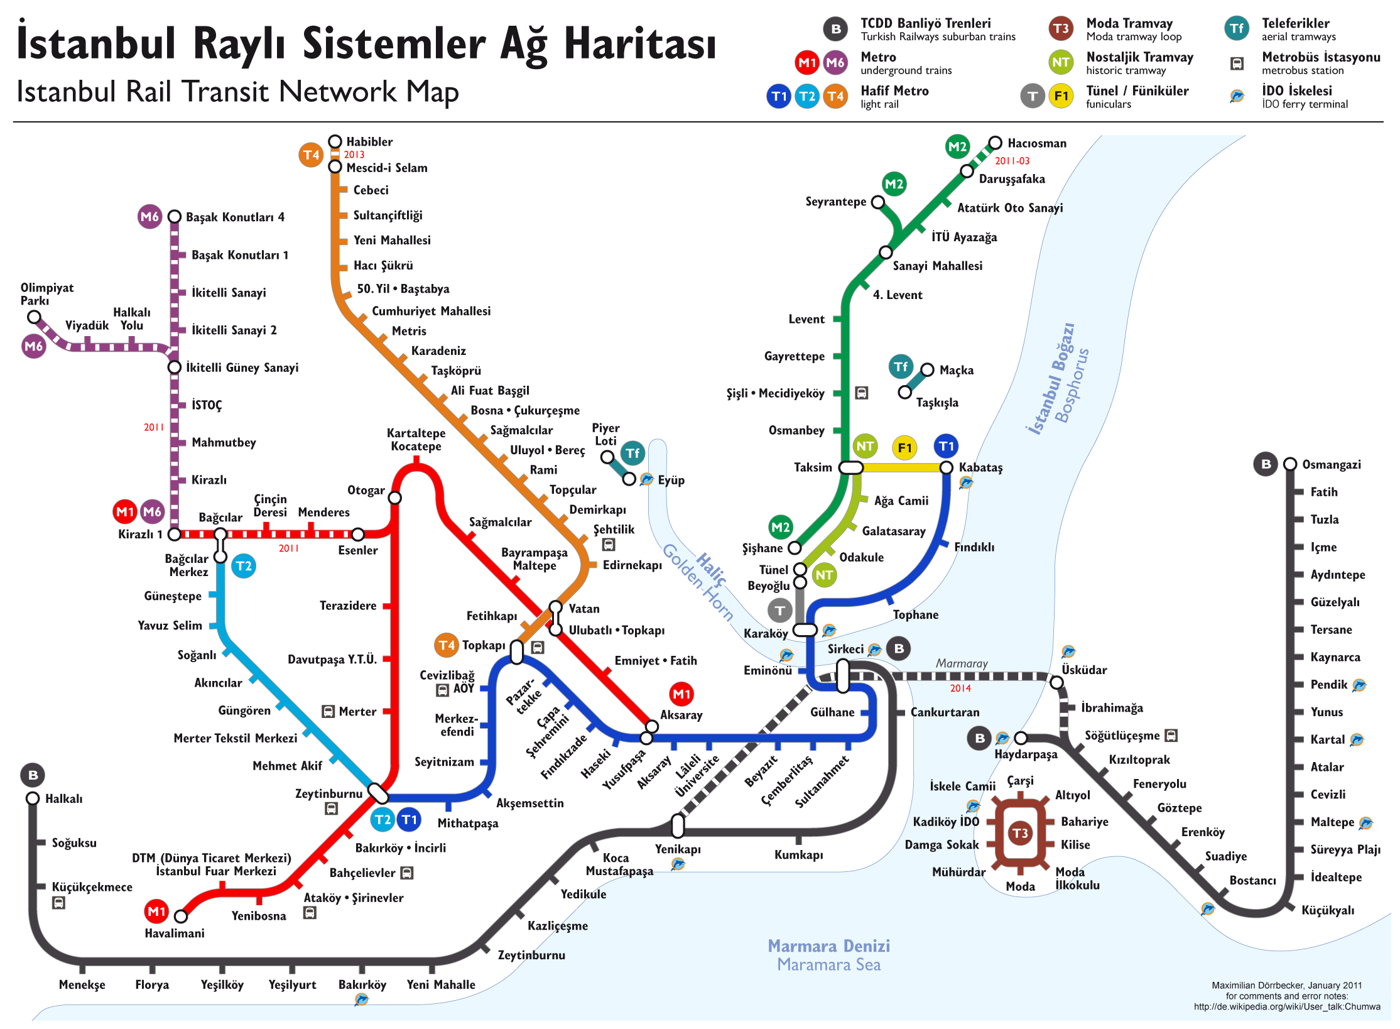
Abstraction
Representational
By generalisation
Even is a kind of modulo function
Later: OO: poodle is kind of dog
Search for numbers is specialization of RE pattern matching
Info hiding
Hide a global variable behind an interface
Procedural abstraction
Refactor “draw wall” to “draw rectangle”
Functional abstraction
Maths library provides sqrt function that hides details
Data abstraction
Stack is an LIFO abstraction; Graph is an adjacency list
Notes:
https://isaaccomputerscience.org/concepts/dsa_ctm_abstraction?examBoard=all&stage=all&topic=computational_thinking

Slide 6
https://trinket.io/blocks

Slide 7
Week 1
Algorithms
Swap variables
Reverse
Linear & binary search
Selection & sort

Slide 8
Operation | With functools.reduce | Without reduce
Sum all | reduce(lambda x, y: x+y, nums) | sum(nums)
Multiply all | reduce(lambda x, y: x*y, nums) | math.prod(nums)
Join strings | reduce(lambda s, t: s+t, strs) | "".join(strs)
Merge dictionaries | reduce(lambda g, h: g|h, cfgs) | ChainMap(*reversed(cfgs))
Set union | reduce(lambda s, t: s|t, sets) | set.union(*sets)
Set intersection | reduce(lambda s, t: s&t, sets) | set.intersect(*sets)
Variables as containers
Accumulator pattern
Accumulator
Map, Filter, Reduce
https://www.pythonmorsels.com/reduce/
def reduce_sum(a): return sum(a)
Min, max, all, any, len,
Happy path if statements
Glowscript
Refactor
Remove hardcoding
Change variable name
Listener loop, sentinel values
Function first
def square(x: int) -> int:
return x * x
Notes:
https://bphilhour.trinket.io/physics-through-glowscript-an-introductory-course#/2-fundamentals-of-stop-motion-animation-kinematics/many-bouncing-balls-lists-and-loops
https://prod.liveshare.vsengsaas.visualstudio.com/join?8742B6FE7AE855FE0D730A88711C70A8C8FE

Slide 9
Swap contents of

Slide 10

Search Algorithms
How would you find the jackpot using the least amount of money?
CC 2.0 BY Daniel X. O'Neil
Notes:
Aim for the least inflated balloon?

Slide 11
Search Algorithms
Algorithms to find a number in a list, e.g. find target 6
Pin the tail on the donkey (Random)
Close your eyes, spin around & point
Open your eyes & compare with your target
Repeat the above if the element does not match your target
Linear search
Point to one of the brackets
Move to the next element
Compare the element with your target
Repeat steps 2-3, if the element does not match
>>> list.index(6)
5

Slide 12
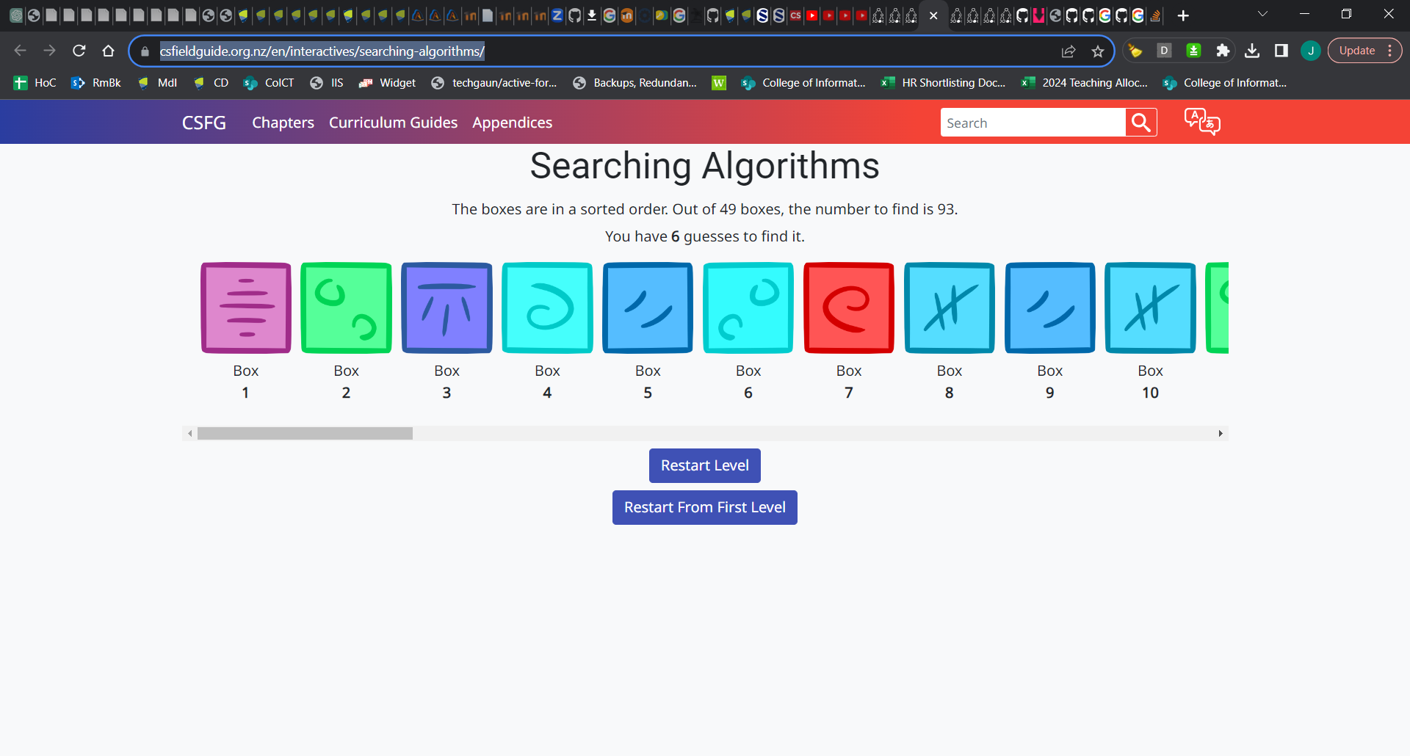
Searching
https://www.csfieldguide.org.nz/en/interactives/searching-algorithms/

Slide 13
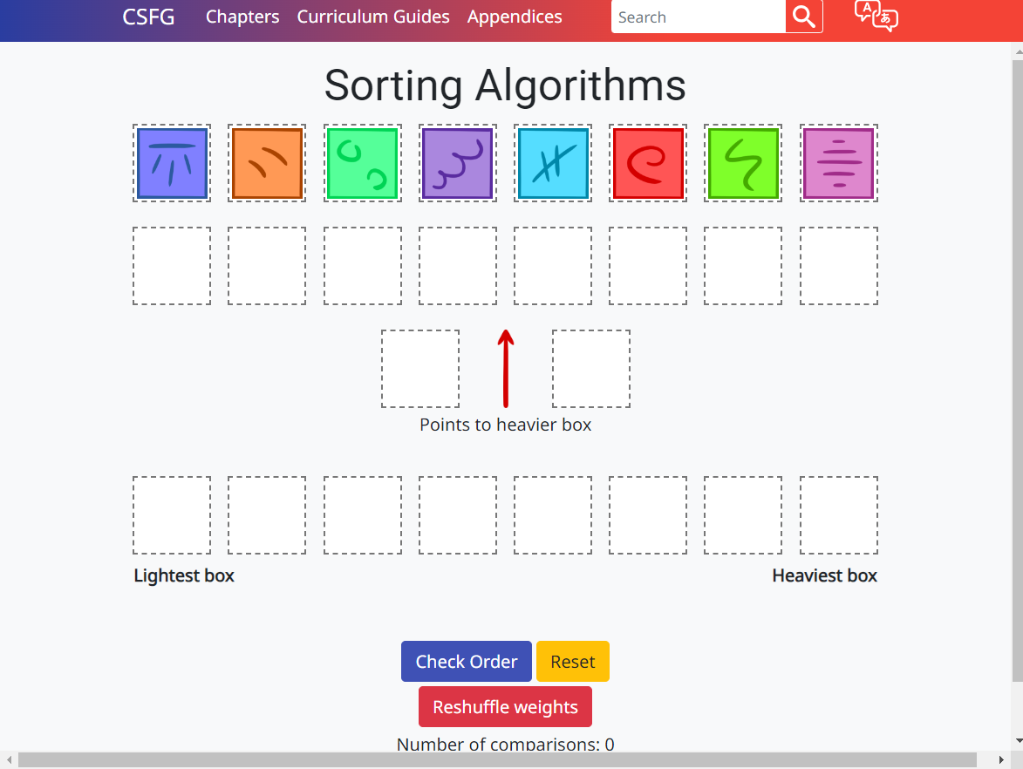
Sorting
https://www.csfieldguide.org.nz/en/interactives/sorting-algorithms/
Notes:
https://www.csfieldguide.org.nz/en/interactives/sorting-algorithms/

Slide 14
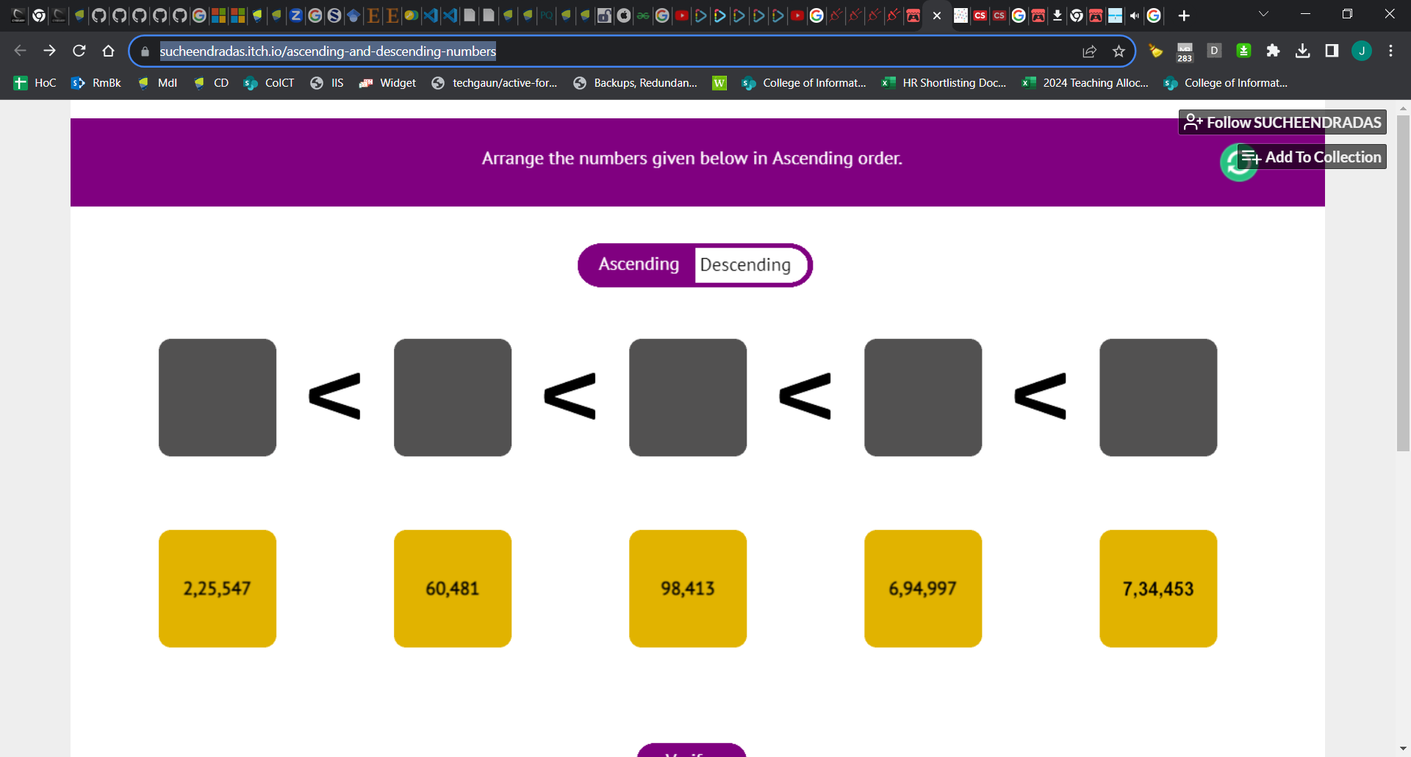



Algorithmic Thinking
Sorting
https://sucheendradas.itch.io/ascending-and-descending-numbers
Pick the largest
Compare each value remembering the largest
Move to last empty point

Slide 15
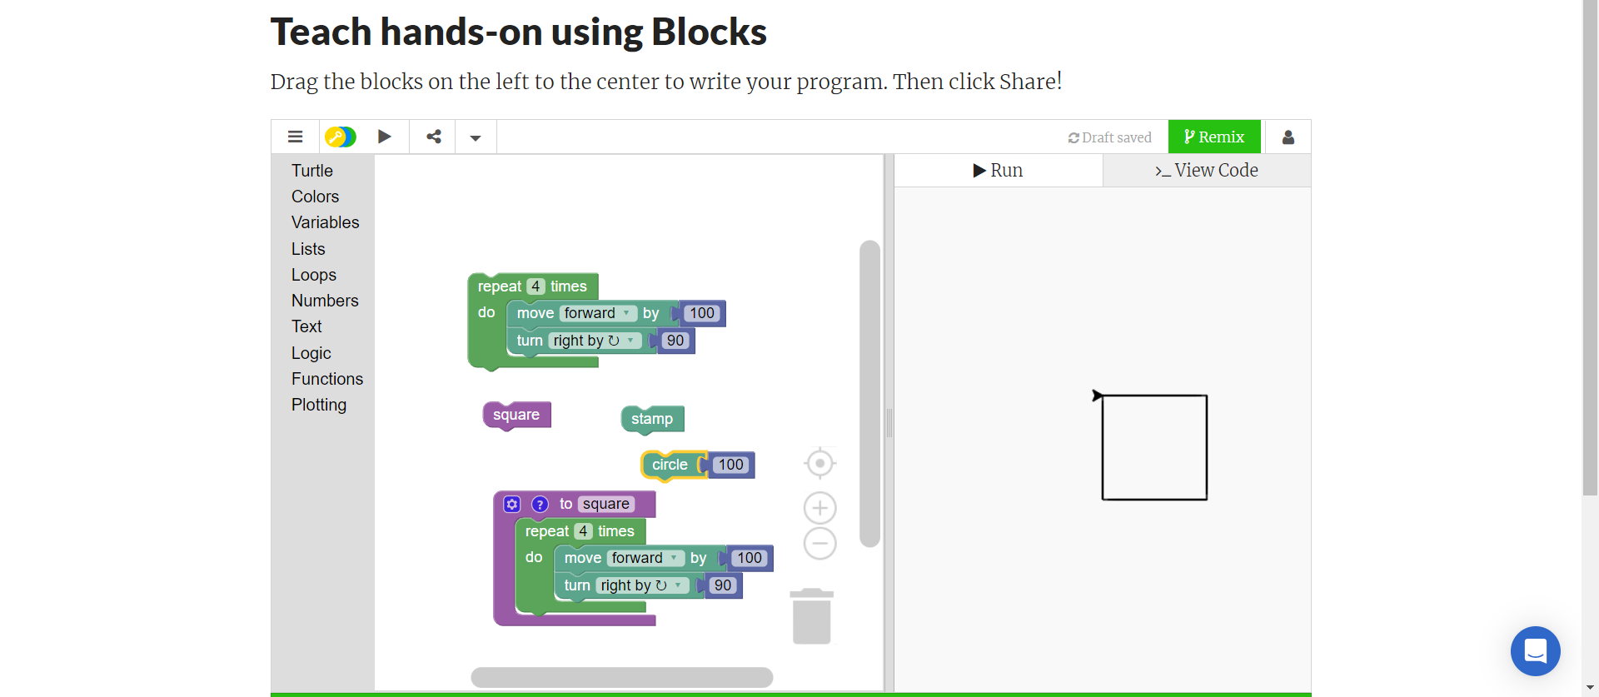
Algorithmic Thinking
Draw a square
Sequencing & figuring out an algorithm

Slide 16
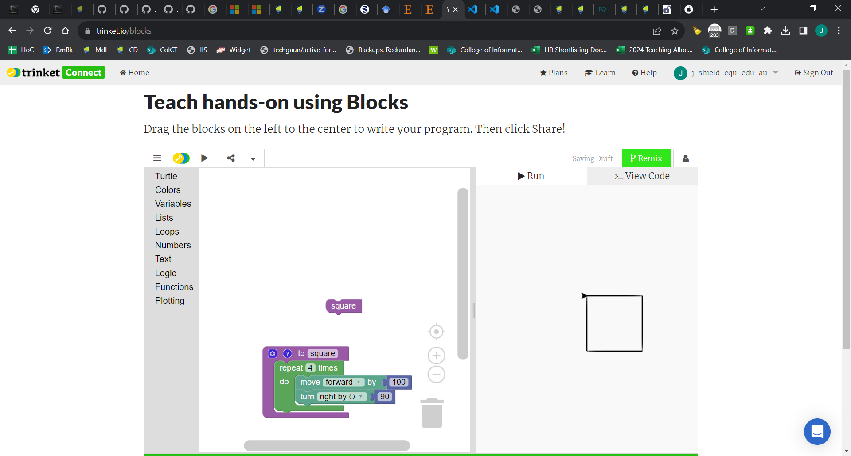
Procedural abstraction
k

Slide 17
Search Algorithms
Algorithms to find a number in a list, e.g. find target 6
>>> list = [ 4, 7, 1, 2, 0, 6, 8 ]
Pin the tail on the donkey (Random)
Close your eyes, spin around & point
Open your eyes & compare with your target
Repeat the above if the element does not match your target
Linear search
Point to one of the brackets
Move to the next element
Compare the element with your target
Repeat steps 2-3, if the element does not match
>>> list.index(6)
5

Slide 18
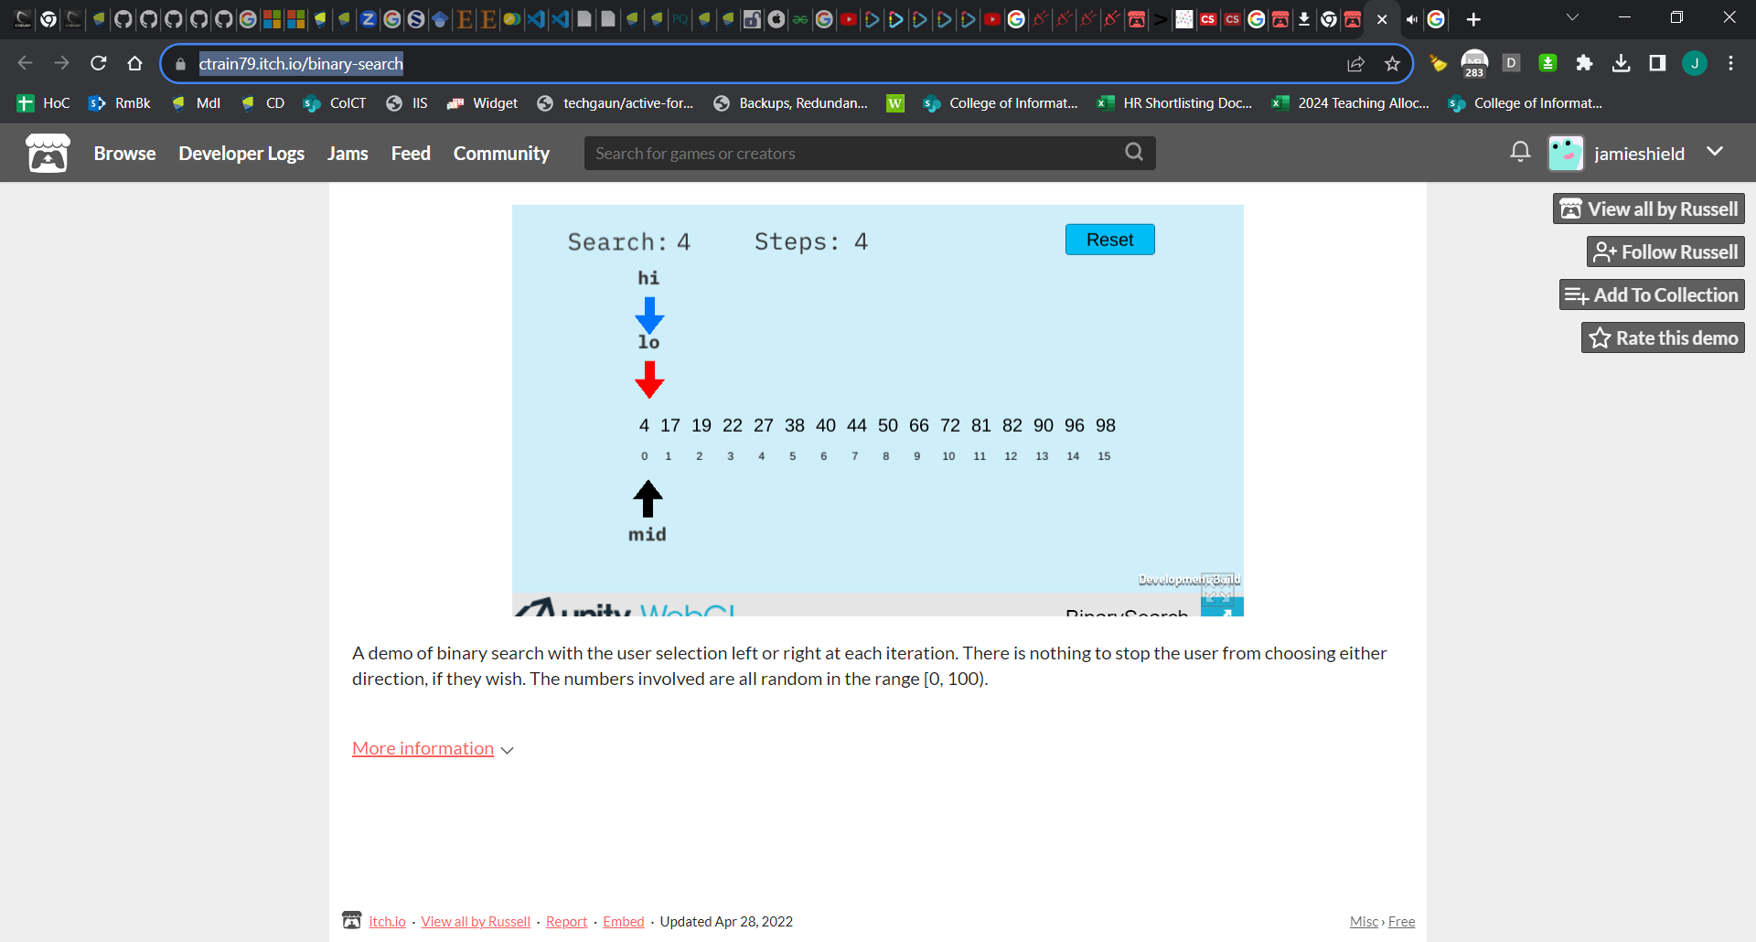
Faster search algorithm
Assuming sorted
https://ctrain79.itch.io/binary-search

Slide 19
Extract method
Also known as procedural abstraction
Print(“*”); Print(“*”); Print(“*”); Print(“*”)
Print(“+”); Print(“+”); Print(“+”); Print(“+”)
def four(x):
print(list(map(function (x) print(x), range(4))
Def four(x):
For a in range(4): print(x)
Notes:
https://journals.sagepub.com/doi/full/10.1177/0735633120932871

Slide 21
Data representation
Strings are ≈ lists of characters
Characters are ≈ numbers
Lists are indexed & sequenced elements

Slide 22
Concurrency

Slide 23

Data Abstraction
j
https://www.csunplugged.org/en/moocs/

Slide 24
Refactor search algorithm
Binary search on list of strings
Binary search on list of list of strings (Umair)
Recursive
ChatGPT
def binary_search_recursive_helper(arr, target, low, high): if low <= high: mid = (low + high) // 2 # Calculate the middle index if arr[mid] == target: # If the middle element is the target, return its index return mid elif arr[mid] < target: # If the middle element is less than the target, search the right half return binary_search_recursive_helper(arr, target, mid + 1, high) else: # If the middle element is greater than the target, search the left half return binary_search_recursive_helper(arr, target, low, mid - 1) else: return -1 # Element not found in the array

Slide 25
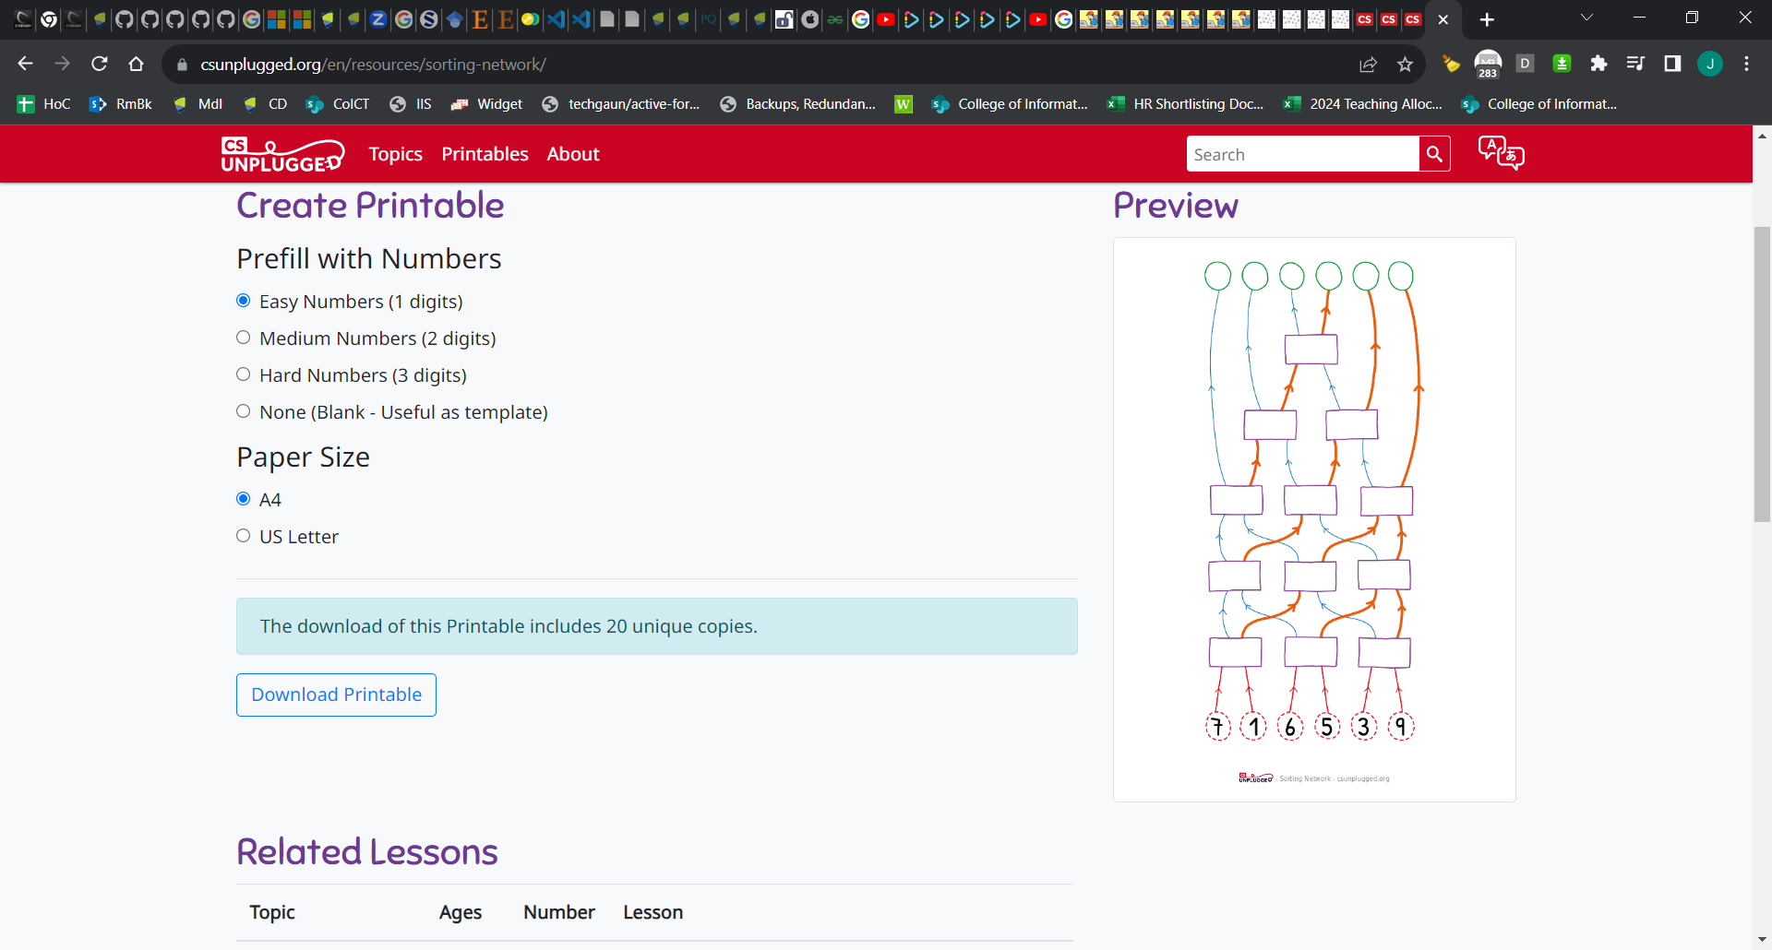
Concurrent Sorting
k
https://www.csunplugged.org/en/topics/sorting-networks/investigating-variations-using-the-sorting-network/
Notes:
http://web.cse.ohio-state.edu/~sivilotti.1/outreach/FESC02/parallel.pdf

Slide 26
Fairy Tales
http://computationaltales.blogspot.com/p/stories-by-level.html

